Slide 1
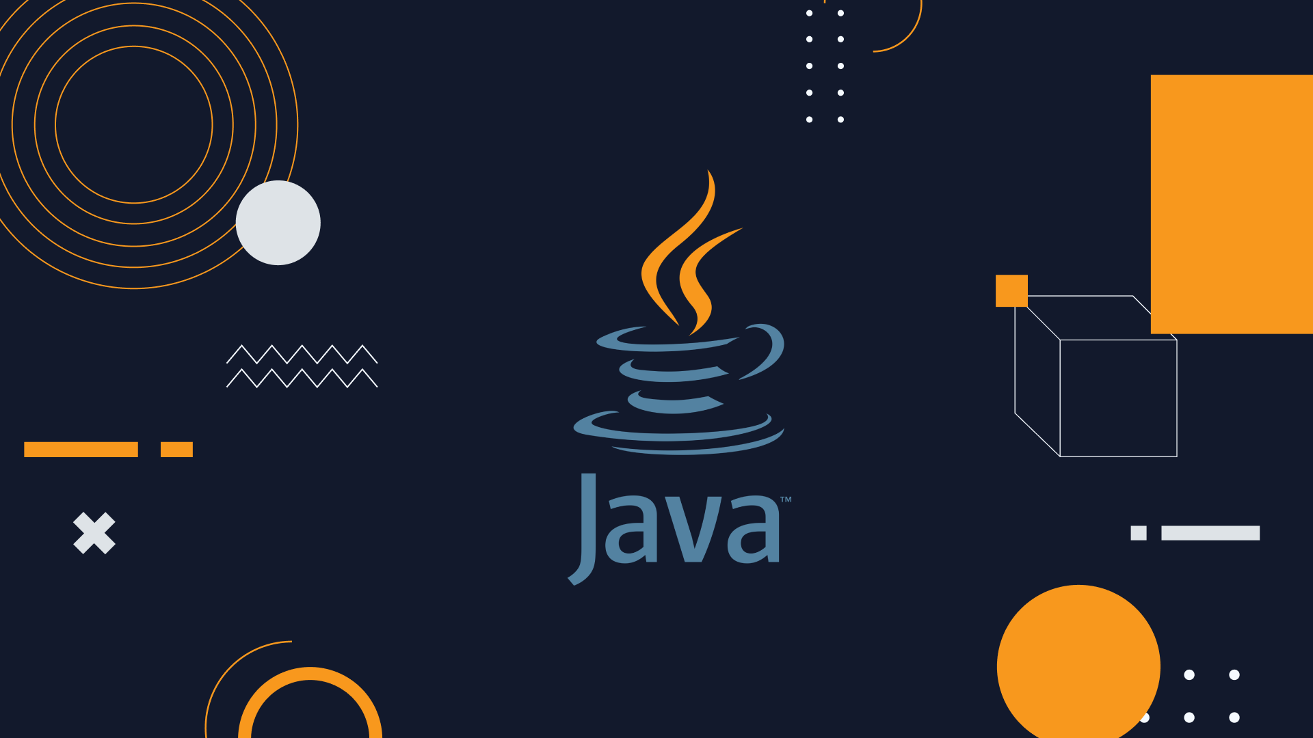
Object Oriented Programming Using
MCA 2nd Semester

Slide 2
Module-1: OOPS CONCEPTS AND JAVA PROGRAMMING:
OOP concepts: Classes and objects, data abstraction, encapsulation, inheritance, benefits of inheritance, polymorphism, procedural and object oriented programming paradigm.
Java programming: History of java, comments data types, variables, constants, scope and life time of variables, operators, operator hierarchy, expressions, type conversion and casting, enumerated types, control flow statements, jump statements simple java stand alone programs, arrays, console input and output, formatting output, constructors methods, parameter passing, static fields and methods, access control, this reference, overloading methods and constructors, recursion, garbage collection, exploring string class

Slide 3
Module-2: MULTIPLE INHERITANCE
Inheritance: Inheritance hierarchies, super and subclasses, member access rules, super keyword,
Preventing inheritance: final classes and methods, the object class and its methods.
Polymorphism: dynamic binding, method overriding abstract classes and methods.
Module-3: INTERFACES AND PACKAGES
Interface: Interfaces VS Abstract classes, defining an interface, implement interfaces accessing implementations through interface references, extending interface.
Packages: Defining creating and accessing a package, understanding CLASSPATH, importing packages

Slide 4
Module-4: EXCEPTION HANDLING
Exception Handling: Benefits of exception handling, the classification of exceptions exception hierarchy, checked exceptions and unchecked exceptions, usage of try, catch, throw, throws and finally. rethrowing exceptions, exception specification, built in exceptions, creating own exception sub classes.
Module-5: GUI PROGRAMMING AND APPLETS
GUI Programming with Java: The AWT class hierarchy, introduction to swing. swangs Vs AWT, hierarchy for swing components.
Containers: JFrame. JApplet, JDialog. Jpanel, overview of some swing components JButton, JLabel, JTextField, JTextArea, simple applications Layout management Layout manager types, border, grid and flow.
Applets: Inheritance hierarchy for applets, differences between applets and applications, life cycle of an applet, passing parameters to applets.

Slide 5
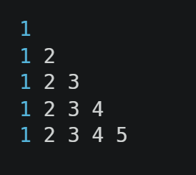
Java Programming Lab:
Write a Java program to print the following triangle of numbers
Write a Java program to list the factorial of the numbers 1 to 10. To calculate the factorial value use while loop. (Hint Fact of 4=4*3*2*1).

Slide 6
3. Write a Java program
To find the area and circumference of the circle by accepting the radius from the user
To accept a number and find whether the number is Prime or not.
4. Write a Java program to demonstrate a division by zero exception.
5. Write a Java program to implement Innes class and demonstrate its Access protection.
6. Write a Java program to demonstrate Constructor Overloading and Method Overloading

Slide 7
7. Write a JAVA program to demonstrate Inheritance Sample Program on Java for the implementation of Multiple inheritance using interfaces to calculate the area of a rectangle and triangle.
8. Write a Java applet program, which handles keyboard event

Slide 8
Demonstration Experiments (For CIE) if any
9. Write a Java Program to create a window when we press
M or m the window displays Good Morning
A or a the window displays Good After Noon
E or e the window displays Good Evening
N or n the window display Good Night
10. Write a lava program to implement a Queue using user defined Exception Handling (also make use of throw, throws) a. Complete the following b. Create a package named shape c. Create somee classes in the package representing some common shapes like Square, Triangle and Circle d. Import and compile these in other program.

Slide 9
What is Programming?
What is Programming Language?

Slide 10
What is Programming? : Writing a Program
What is Programming Language? : Is a Collection of Tokens.

Slide 11
What is a Token:
A Token is a smallest individual units of a Program.
In Java, tokens are the smallest elements of a program that are meaningful to the compiler. Java programs are made up of these tokens.
Java Tokens:
Keywords: Predefined Words like, class, if, switch etc
Identifiers: Name given to the programming elements such as class, variables and so on.
Literals: Constant values that are assigned to variables
Operators: Symbols that perform operations on variables and values
Separators (or Delimiters): Characters that separate tokens in the code. Ex: {}, [], (), and so on
Comments: Text within the code that is not executed but provides explanations or annotations.

Slide 12
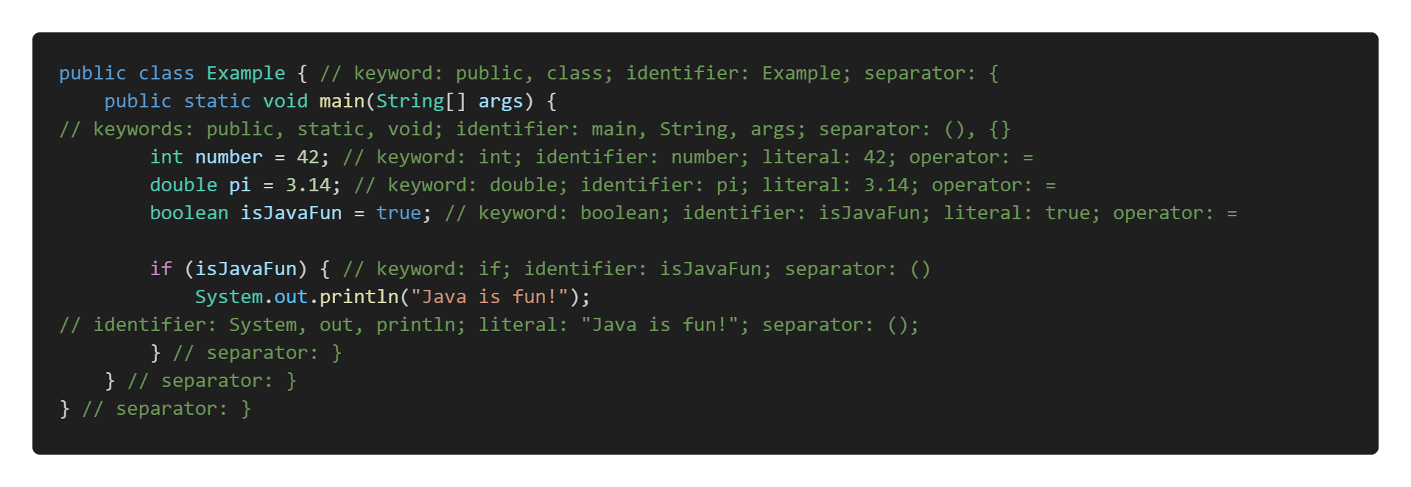
Example:

Slide 13
What is Java:
Java is a High Level, General Purpose, Object Oriented, Platform Independent, Compiled and Interpreted, Statically Typed, Highly Secured programming language.
Java is Developed By: James Gosling, Patrick Naughton, and Mike Sheridan

Slide 14
History of Java:
Early Beginnings
1991: Project Initiation
Java began as a project called "Oak" by Sun Microsystems, led by James Gosling, Mike Sheridan, and Patrick Naughton. They were part of a team at Sun Microsystems that initiated the project in the early 1990s. The goal was to develop a language for embedded systems in consumer electronics, , and it eventually evolved into the Java programming language we know today.
1992: Green Project
The team, known as the Green Team, worked on creating a platform-independent language. They aimed to create a language that could run on various devices, including televisions, toasters, and other consumer electronics.
1994: Transition to the Web
The team realized the potential of their new language for the burgeoning World Wide Web, where the ability to run the same program on different platforms was highly desirable. They renamed Oak to Java, inspired by Java coffee, which was consumed in large quantities by the developers.

Slide 15
Official Launch
1995: Public Introduction
Java 1.0 was officially released by Sun Microsystems. The "Write Once, Run Anywhere" (WORA) capability became a significant selling point, allowing Java programs to run on any device with a Java Virtual Machine (JVM).
Evolution and Growth
1996: Java Development Kit (JDK) 1.0
Sun Microsystems released JDK 1.0, providing developers with the tools needed to develop Java applications.
1997-1999: Rapid Evolution
Java 1.1 was released in 1997, introducing new features like inner classes and JavaBeans.
In 1998, Java 2 (formerly known as JDK 1.2) introduced major enhancements to the platform, including the Swing graphical API and the Collections framework.
Java Community Process
1999: Establishment of the Java Community Process (JCP)
The JCP was established to allow for the participation of the broader Java community in the development and evolution of Java standards and specifications.

Slide 16
Open Source and Later Versions
2006: Open Sourcing of Java
Sun Microsystems announced that Java would be released under the GNU General Public License (GPL), making it open-source and allowing the community to contribute to its development.
2009: Acquisition by Oracle
Oracle Corporation acquired Sun Microsystems, becoming the steward of Java. This led to concerns about the future direction of Java, but Oracle continued to develop and support the language.
2011-Present: Ongoing Evolution
Java 7 was released in 2011, introducing new language features and performance improvements.
Java 8, released in 2014, brought significant changes, including the introduction of lambda expressions, the Stream API, and the new date and time API.
Subsequent versions (Java 9 through Java 20) have continued to add new features, enhance performance, and improve the language's capabilities.
Java 22, officially released on March 19, 2024

Slide 17
Flavours of Java:
1. Java Standard Edition (Java SE)
Purpose: Java SE provides the core functionality for general-purpose programming. It includes the Java Development Kit (JDK), which contains the Java Runtime Environment (JRE), a compiler (javac), and various development tools.
2. Java Enterprise Edition (Java EE), now Jakarta EE (Web Applications)
Purpose: Java EE is designed for building large-scale, distributed, and component-based applications in the enterprise environment.
3. Java Micro Edition (Java ME) (Android)
Purpose: Java ME is tailored for resource-constrained devices like embedded systems, mobile phones, and Internet of Things (IoT) devices.

Slide 18
Features of Java:
Object-Oriented: Java follows an object-oriented programming model, which allows for the creation of modular, reusable code. It supports features like inheritance, polymorphism, encapsulation, and abstraction.
Platform-Independent: Java's "write once, run anywhere" capability is facilitated by the Java Virtual Machine (JVM). Java code is compiled into bytecode, which can run on any system equipped with a JVM, making Java applications highly portable.
Secure: Java provides a secure environment through its runtime environment.
High Performance: Although Java is an interpreted language, the use of Just-In-Time (JIT) compilers helps improve its performance by converting bytecode into native machine code at runtime.
Multi-Threaded: A thread is the smallest unit of a process that can be scheduled and executed independently by the operating system. It is a lightweight process that shares the same memory space and resources of the parent process but can execute code concurrently.
Compiled & Interpreted: Java has both Compiler and Interpreter.

Slide 19
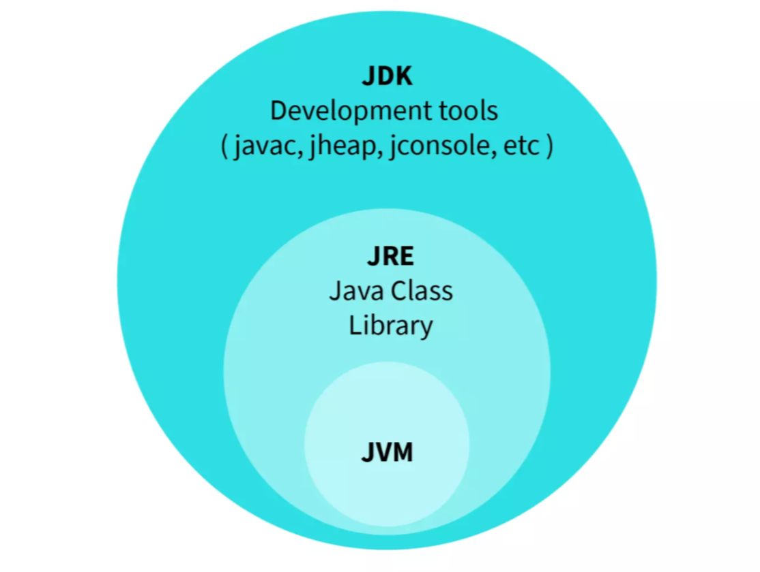
JDK (Java Development Kit)
The Java Development Kit (JDK) is a software development environment used for developing Java applications and applets. It provides the necessary tools, libraries, and resources to create and execute Java programs.

Slide 20
JRE (Java Runtime Environment)
The Java Runtime Environment (JRE) is a software package that provides the necessary libraries, Java Virtual Machine (JVM), and other components to run applications written in the Java programming language. It is a part of the Java Development Kit (JDK) but can also be installed separately. The JRE is designed to provide an environment for executing Java applications, not for developing them.

Slide 21
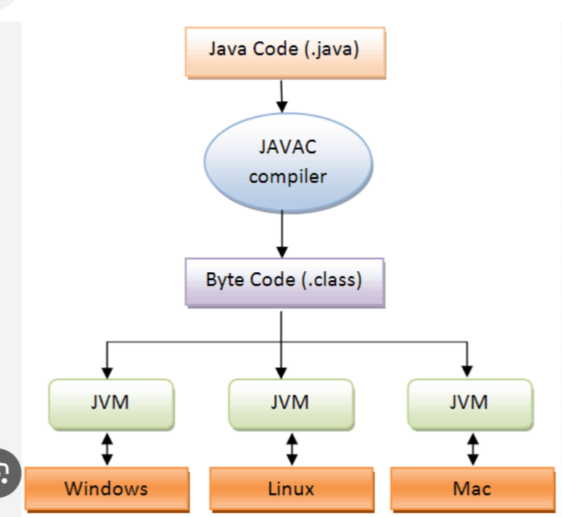
Java Virtual Machine (JVM) :
The JVM is the core component of the JRE that executes Java bytecode. It provides a platform-independent execution environment, meaning Java applications can run on any device or operating system that has a compatible JVM.

Slide 22
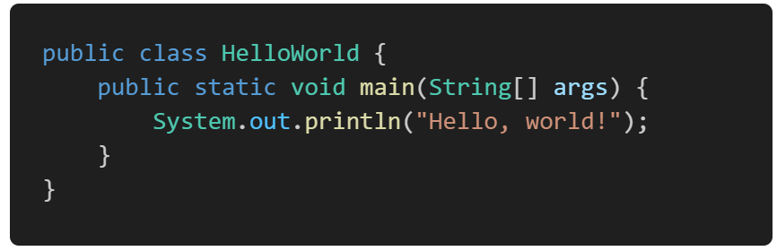
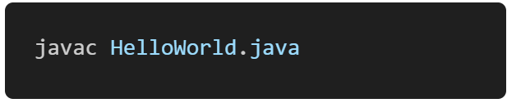
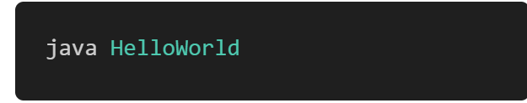
How to Run the Java Program:
1. Write Your Java Program:
Example: HelloWorld.java
2. Compile the Java Program using javac:
3. Run the Compiled Java Program using java:

Slide 23
Comments, Data types, Variables

Slide 24
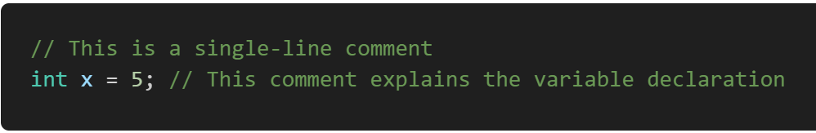
Comments:
In Java, comments are annotations in the source code that are ignored by the compiler and the runtime environment. They are intended to make the code easier to understand for humans by explaining the purpose, logic, or structure of the code.
There are 3 types of comments in Java:
Single-Line Comments: These comments start with // and continue to the end of the line.

Slide 25
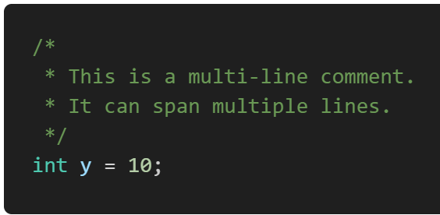
2. Multi-Line Comments: These comments start with /* and end with */. They can span multiple lines.
3. Documentation Comments: These comments start with /** and end with */. They are used to generate documentation using the Javadoc tool.
Javadoc is a tool provided by the Java Development Kit (JDK) that generates HTML documentation from Java source code with special comments called documentation comments.
Run Javadoc: javadoc -d doc <source-files>

Slide 26
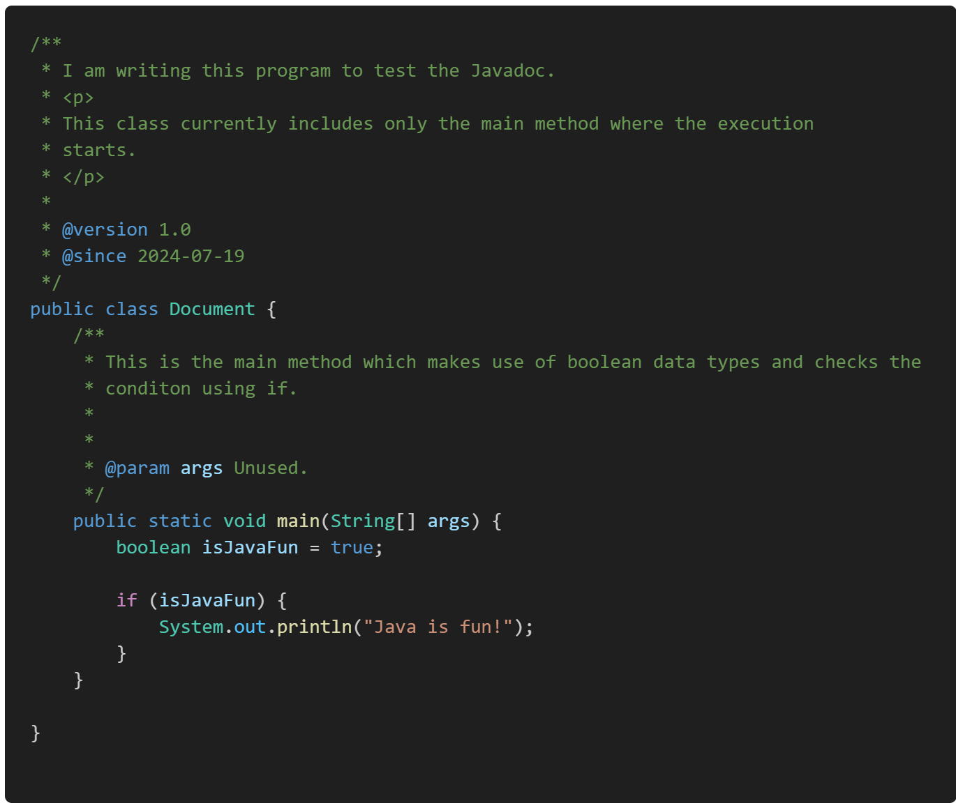
Example:
Run:
javadoc -d doc Document.java

Slide 27
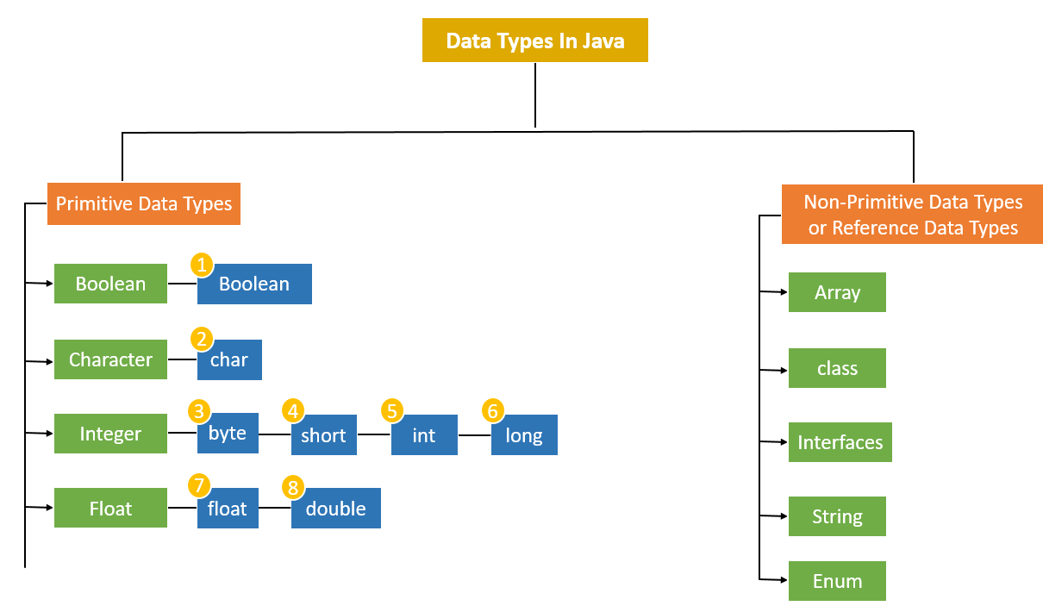
Data types:
1 bit
2 bytes
1 byte
2 bytes
4 bytes
8 bytes
4 bytes
8 bytes

Slide 28
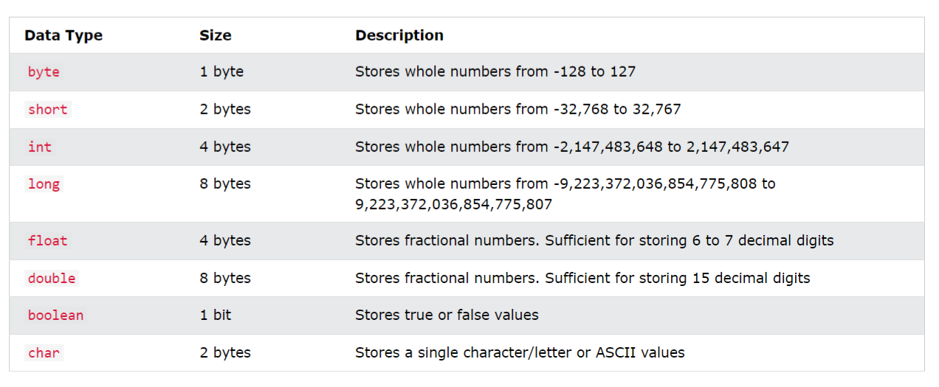
Primitive Types:
Java has 8 primitive data types, which are the most basic data types available within the language. They are predefined by the language and named by a reserved keyword.

Slide 29
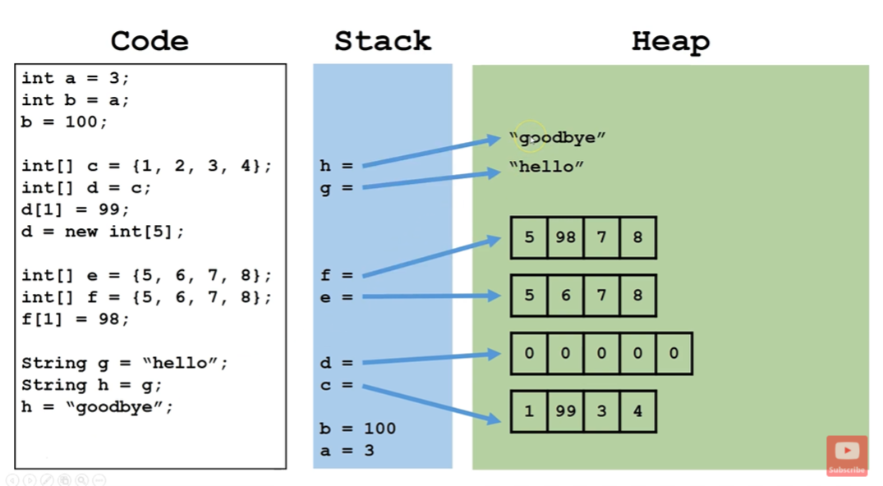
Non-Primitive or Reference Types:
In Java, non-primitive or reference types are more complex data types that refer to objects and arrays. Unlike primitive types, which store actual values, reference types store references to memory locations where the objects are stored.

Slide 30
String:
In Java, a String is an object (of String class) that represents a sequence of characters. Strings are widely used in Java programming and are a crucial part of the Java language. The String class is immutable, meaning that once a String object is created, its value cannot be changed.
Key Features of Strings in Java
Immutable: The content of a String object cannot be changed after it is created. Any modification of a string results in the creation of a new String object. So we can reassign new sequence of character to the String Object but we cannot modify the content or char of the String directly by using index.
String Pool: Java uses a special memory region called the string pool to store string literals. When a new string literal is created, Java checks the string pool first. If the string already exists in the pool, a reference to the existing string is returned, otherwise, the new string is added to the pool.
String Class: The String class is part of the java.lang package and is implicitly imported.

Slide 31
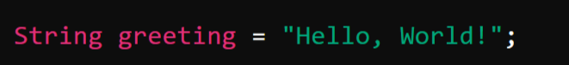
Creating Strings
1. Using String Literals:
2. Using the new Keyword:

Slide 32
Commonly Used Methods: String name = “Shridevi College”
Function | Working | Example
length() | Returns the length of the string. | name.length(); returns 16
charAt(int index) | Returns the character at the specified index. | name.charAt(0); returns ‘S’
substring(int beginIndex, int endIndex) | Returns a substring from beginIndex to endIndex. | name.substring(0,3); returns “Shri”
contains(CharSequence sequence) | Checks if the string contains the specified sequence. | name.contains(“Shri”); returns true
indexOf(String str) | Returns the index of the first occurrence of the specified substring. | name.indexOf(“College”); returns 9;

Slide 33
toUpperCase() | Converts all characters in the string to uppercase. | name.toUpperCase(); return “SHRIDEVI COLLEGE”
toLowerCase() | Converts all characters in the string to lowercase. | name.toLowerCase(); return “Shridevi college”

Slide 34
Array:
An array in Java is a data structure that allows you to store multiple values of the same type in a single variable. Arrays are useful for managing collections of data that can be accessed using an index.
Key Features of Arrays in Java:
Fixed Size: Once an array is created, its size cannot be changed. You must specify the number of elements it will hold when you create it.
Indexed Access: Each element in an array can be accessed using its index, with the first element at index 0 and the last element at index length-1.
Homogeneous Elements: All elements in an array must be of the same type, such as int, String, boolean, etc.
Zero-Based Indexing: The index of the first element is 0, and the index of the last element is length-1.

Slide 35




Declaring and Initializing Arrays:
Declaring-> Syntax: Example:
Initializing-> Syntax: Example:

Slide 36

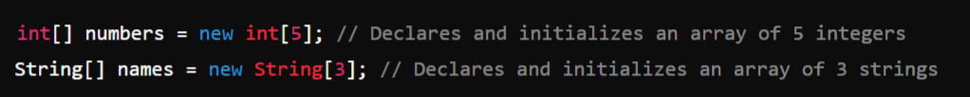
We can combine declaration and initialization in one step:
Syntax:
Example:

Slide 37

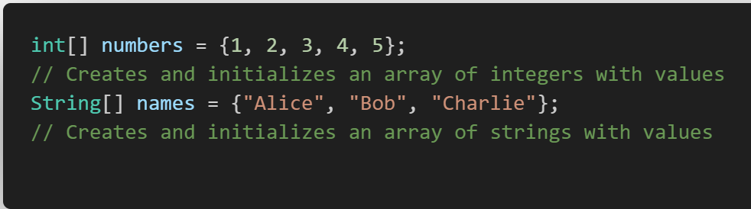
Directly Assign the Values and the size will be detected by the compiler:
Syntax:
Example:

Slide 38
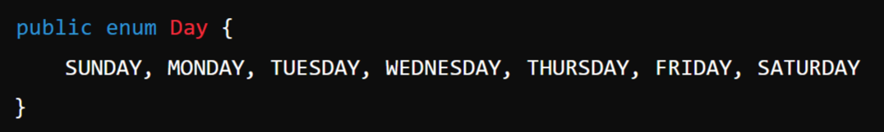
Enum: (Creating our Own Type)
In Java, an enum (short for "enumeration") is a special data type that enables a variable to be a set of predefined constants. It is used to represent a fixed set of related constants more efficiently and readably.
Definition: Enums are defined using the enum keyword. Each value in an enum is called an enum constant.
Example:
Note:
In Enum we are creating our own data type which can hold only the constant specified to it while defining it which is called enum constants.

Slide 39
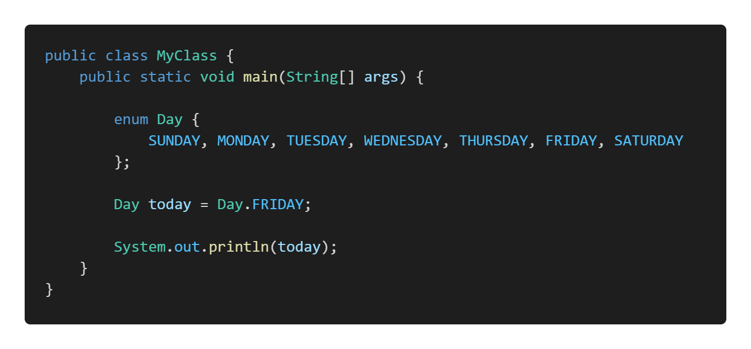
Example:

Slide 40
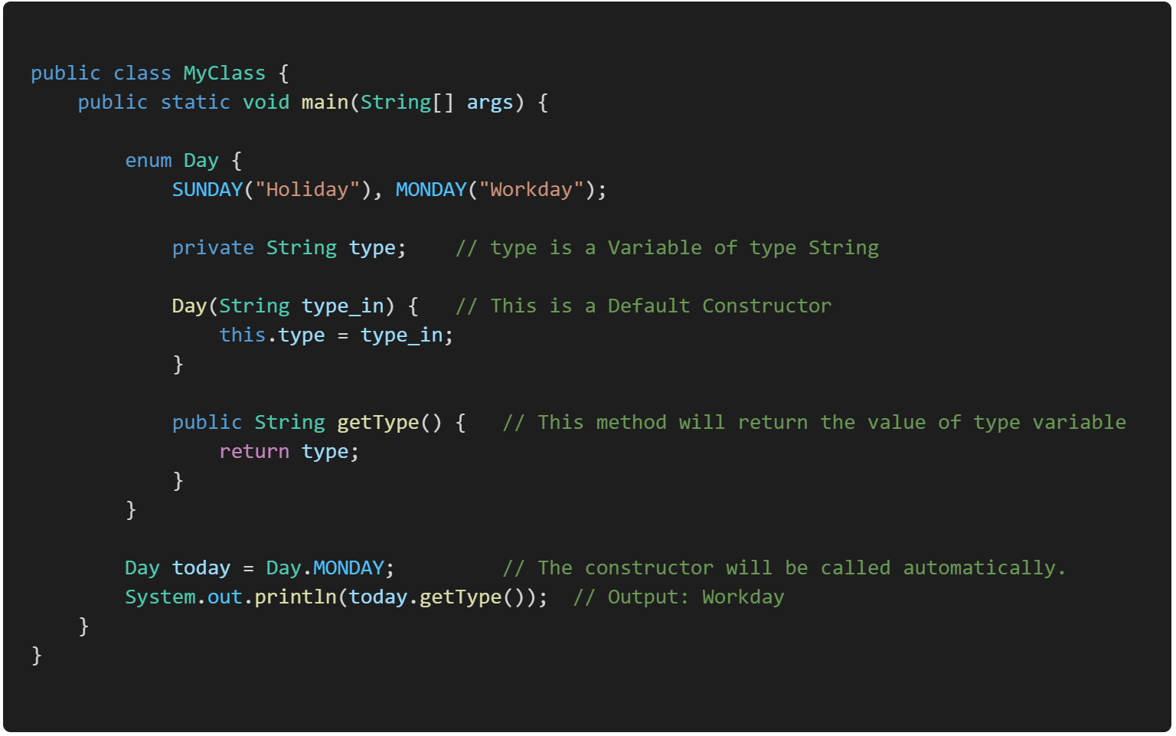
Example: We can have Functions and Constructor for our Enum

Slide 41
Class & Interface

Slide 42
Evolution of Data Storing Technique:
Variables (Single Value)
Array (Multi-Value but Homogeneous)
Structure & Union (No OOP’s and No Methods)
Class

Slide 43
Procedural and Object Oriented Programming Paradigm:
1. Procedural Programming Paradigm:
Definition: Procedural programming is a programming paradigm based on the concept of procedure calls, where the program is structured into procedures, also known as functions or routines.
Example: C, Pascal, Fortran.
2. Object-Oriented Programming (OOP) Paradigm:
Definition: Object-oriented programming is a paradigm based on the concept of "objects," which are instances of classes that encapsulate both data and methods.
Example: Java, C++, Python, C#.

Slide 44
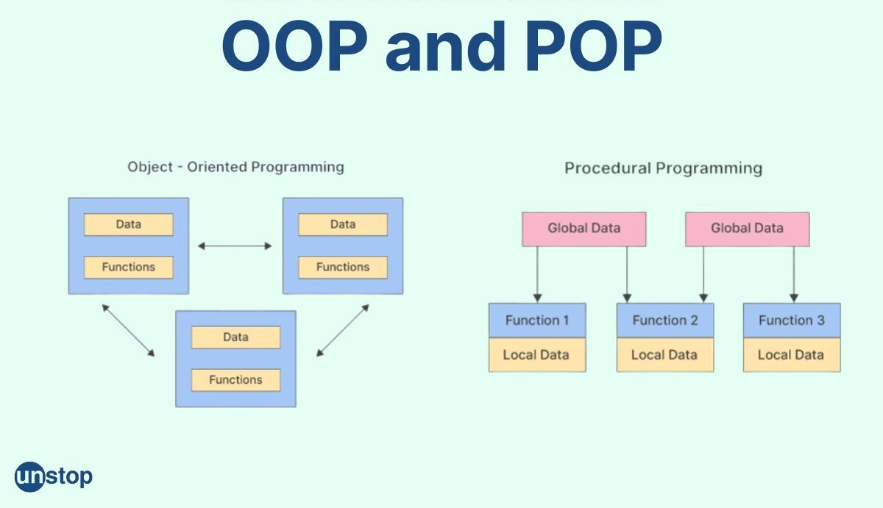


Slide 45
Parameter | Object Oriented Programming(OOP) | Procedure Oriented Programming(POP)
Definition | OOP refers to Object Oriented Programming. It deals with objects and their properties. | POP refers to Procedural Oriented Programming and deals with programs and functions.
Approach | An object-oriented program uses the bottom-up approach. | A procedure-oriented program uses the top-down approach.
Access Control | Access control is supported by the means of access modifiers. The access specifiers such as public, private and protected are used. | No access modifiers are supported.
Data Hiding | Data can be hidden using encapsulation. | There is no data-hiding mechanism. Data is globally accessible, as there are no access specifiers.
Entity Linkage | Object functions are linked through message passing. | Parameter passing is involved in message passing.
Polymorphism | Method overloading and method overriding are used in OOP to achieve polymorphism. | POP does not support polymorphism.
Virtual Function and Inheritance | OOP supports inheritance and virtual functions and virtual classes via it. | There is no concept of inheritance in POP and neither does it support the use of virtual classes or virtual functions.
Code Reuse | OOP supports code reusability. | No code reusability is provided by POP.
Operator Overloading | It is allowed in OOP. | Operator overloading is not allowed in POP.

Slide 46
Top-Down:
The top-down approach is a method of designing a system by starting from the highest level of abstraction and progressively breaking it down into more detailed components. In this approach, the overall structure and functionality of the system are defined first, and then specific components and details are developed.
Starts with an overview and breaks it down. It's like starting with the full picture and filling in the details.
Bottom-Up:
The bottom-up approach is a method of designing a system by starting with the most basic and fundamental components and gradually integrating them to form higher-level systems. In this approach, small, independent modules or components are developed first, and then they are combined to build the complete system.
Starts with small details and builds up. It's like gathering all the pieces and then assembling the full picture.

Slide 47
OOP’s concepts:
Object-Oriented Programming (OOP) is a programming paradigm that uses objects and classes to design and develop applications. In Java, OOP principles are fundamental to creating reusable, scalable, and maintainable code.
The main principles of OOP in Java:
Class & Objects
Encapsulation
Inheritance
Polymorphism
Data Abstraction

Slide 48
Note:
Class
Data Member OR Variable
Member Function OR Function OR Method OR Sub-Routine

Slide 49
1. Class & Objects
In Java, a class is a blueprint for creating objects. It defines a datatype by bundling data (attributes) and methods (functions) that operate on the data into a single unit.
Class:
Definition: A class is defined using the class keyword followed by the class name and a body enclosed in curly braces.
Components: It typically includes fields (variables) and methods to define the behavior and state of the objects created from the class.

Slide 50
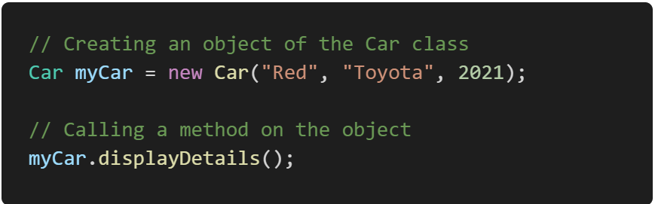
Object
Definition: An object is an instance of a class. When a class is instantiated, memory is allocated for the object, and the constructor of the class is called to initialize the object.
Creation: Objects are created using the new keyword.
Create and use an object of the Car class:

Slide 51
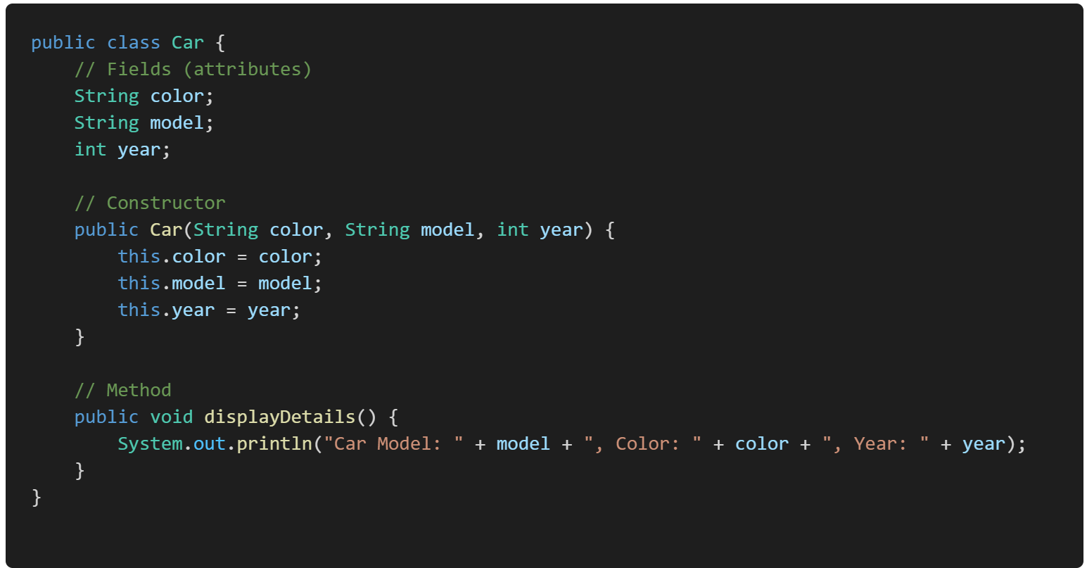
Example:

Slide 52
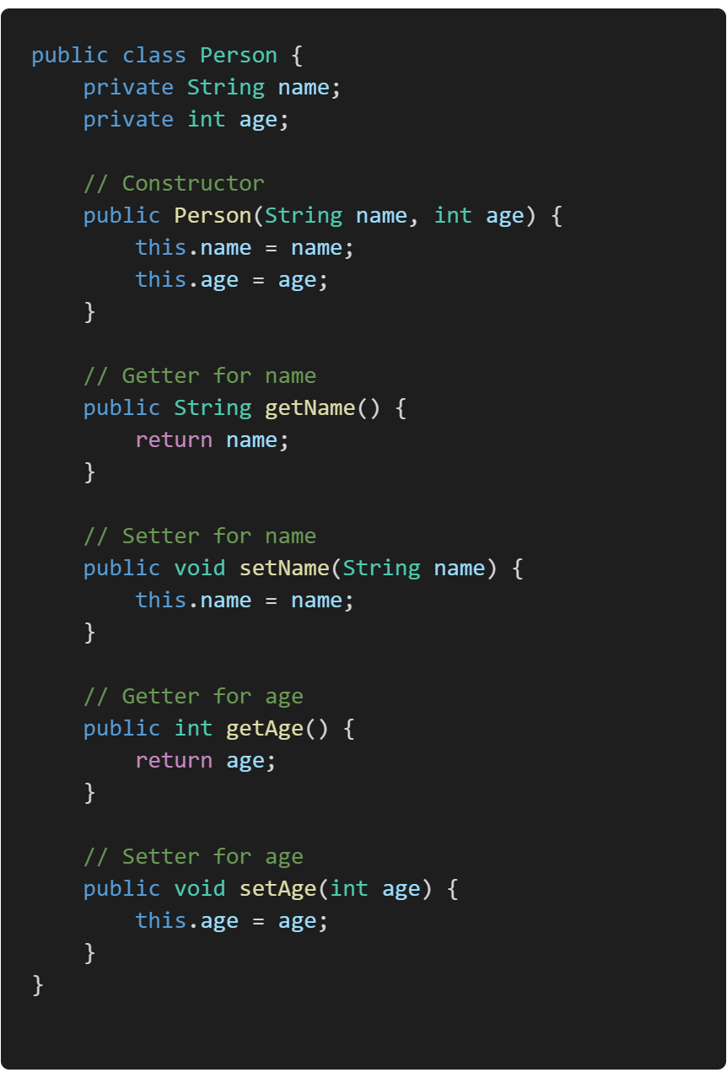
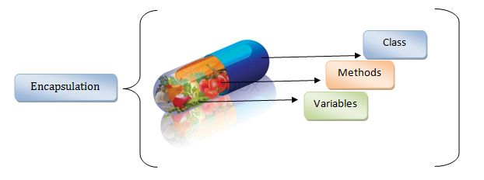
2. Encapsulation
Encapsulation is the mechanism of bundling data (fields) and methods (functions) that operate on the data into a single unit or class, and restricting access to some of the object's components. This is achieved using Access Modifiers or Specifiers such as private, protected, and public.

Slide 53
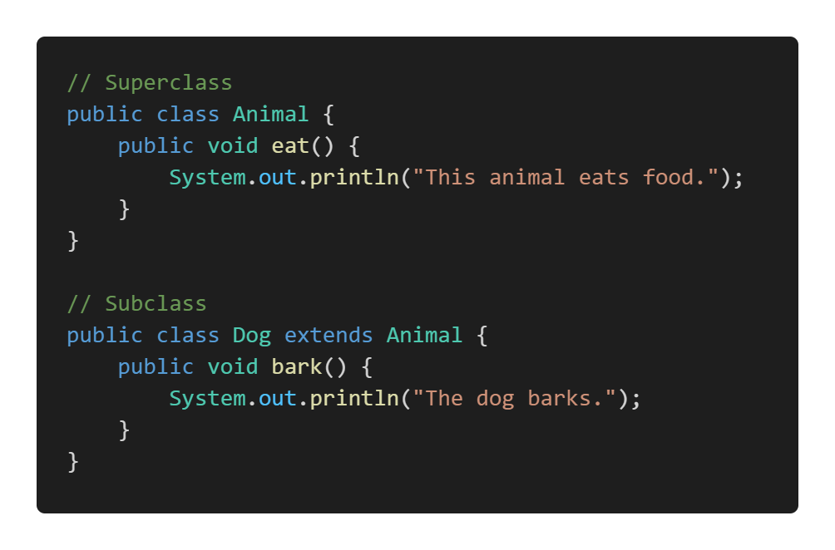
3. Inheritance: (Do not Re-Invent the Wheel)
Inheritance is a mechanism wherein a new class is derived from an existing class. The new class (child or subclass) inherits the fields and methods of the existing class (parent or superclass), allowing for code reuse and the creation of a hierarchical relationship between classes.

Slide 54
Benefits of Inheritance:
1. Reusability
Code Reusability: Inheritance promotes code reusability by allowing new classes to use methods and properties of existing classes. This means you can create a new class with minimal additional code.
DRY Principle: It helps adhere to the "Don't Repeat Yourself" (DRY) principle, reducing code duplication and making maintenance easier.
2. Maintainability
Centralized Changes: When a method or property in the superclass is modified, all subclasses that inherit from it automatically inherit the changes. This centralizes updates and bug fixes, making the codebase easier to maintain.
Consistency: Changes made in the superclass ensure consistency across all subclasses, reducing the risk of inconsistencies and errors.
3. Extensibility:
Adding Functionality: Inheritance allows for the extension of existing functionality. Subclasses can add new methods or override existing ones to provide specialized behavior while still leveraging the existing code in the superclass.
Modular Development: It promotes modular development by enabling you to build classes in a hierarchical and organized manner.
4. Polymorphism
Dynamic Method Binding: Inheritance is closely related to polymorphism, which allows a subclass to be treated as an instance of its superclass. This enables dynamic method binding (method overriding) where a method call is resolved at runtime, allowing for more flexible and dynamic code.
Interface Implementation: Subclasses can implement methods in different ways, allowing for diverse behavior while maintaining a common interface.

Slide 55
5. Reduced Code Complexity:
Simpler Class Definitions: Subclasses can inherit complex behavior from superclasses, leading to simpler and cleaner class definitions.
Focus on Specific Functionality: Developers can focus on implementing specific functionality in subclasses without worrying about the common functionality already handled by superclasses.
6. Simplified Debugging and Testing
Inheritance Hierarchies: By organizing code into inheritance hierarchies, it becomes easier to understand, debug, and test. Common behavior is isolated in the superclass, which simplifies testing and reduces the likelihood of bugs.
Behavioral Consistency: Testing at the superclass level ensures that all inherited behavior in subclasses is correct, further simplifying the testing process.
7. Improved Organization
Logical Structure: Inheritance provides a logical structure and hierarchy to the codebase. This makes it easier to understand the relationships between different classes and their roles within the application.
Clearer Relationships: It clarifies the relationships between classes, making the system's design and architecture more intuitive.

Slide 56
4. Polymorphism:
In Polymorphism Poly means many, morphism means form together it says More than One Form.
Polymorphism allows objects of different classes to be treated as objects of a common superclass (through Method Overriding or Dynamic/ Late Binding). It is mainly achieved through method overriding (runtime polymorphism) and method overloading (compile-time polymorphism).
Important:
Method & Constructor Overloading & Operator Overloading (compile-time polymorphism)
Method Overriding (through Inheritance) (runtime polymorphism)

Slide 57
5. Data Abstraction
Abstraction is the concept of hiding the complex implementation details and showing only the essential features of an object. In Java, abstraction is achieved using abstract classes and interfaces.
Important:
Abstract Class
Interface

Slide 58
Control Flow Statements:
Java control flow statements are constructs that dictate the order in which instructions are executed.
They can be categorized into 3 main types:
Branching or Decision-making statements
Loop statements
Jump statements

Slide 59
Decision-Making Statements:
Decision-Making statements control the flow of execution based on certain conditions. These statements allow the program to choose different paths of execution based on the evaluation of Boolean expressions.
Main decision-making statements:
if
if-else
if-else-if ladder
nested if
switch

Slide 60
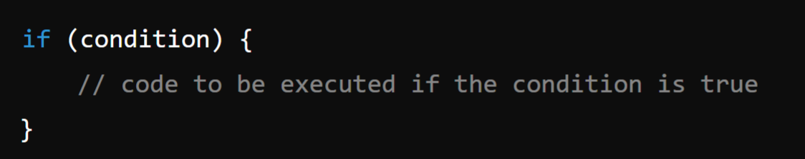
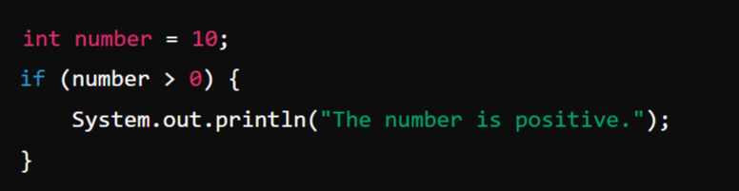
1. if statement:
The if statement evaluates a condition (a Boolean expression). If the condition is true, the block of code within the if statement is executed. If the condition is false, the block is skipped.
Syntax:
Example:

Slide 61
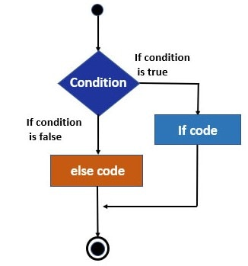
Simple If Flow Chart

Slide 62
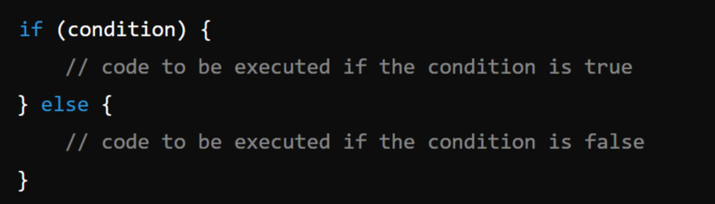
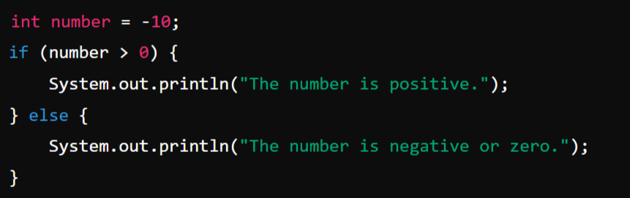
2. if-else statement:
The if-else statement provides two blocks of code: one that executes if the condition is true and another that executes if the condition is false.
Syntax:
Example:

Slide 63
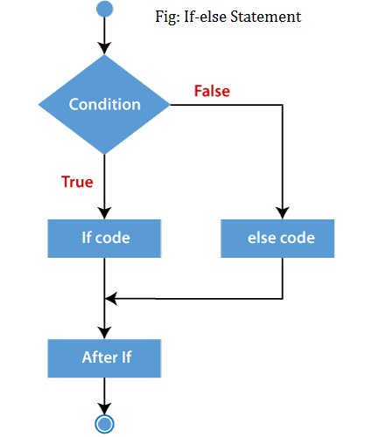
if-else Flow Chart

Slide 64
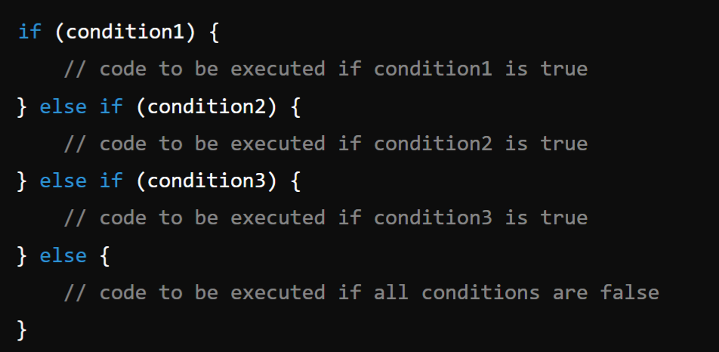
3. if-else-if ladder:
The if-else-if ladder allows for multiple conditions to be evaluated sequentially. The first condition that evaluates to true will have its corresponding block executed, and the rest of the ladder will be skipped. If none of the conditions are true, the else block (if present) will be executed.

Slide 65
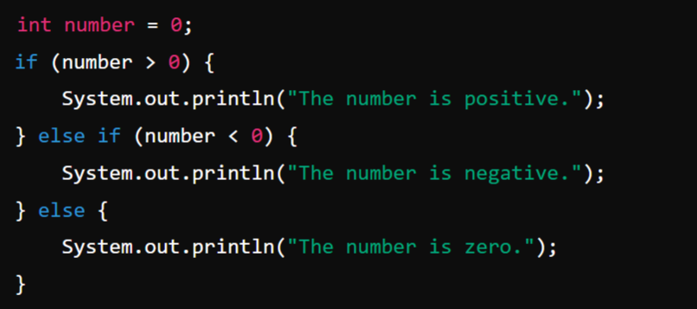
Example:

Slide 66
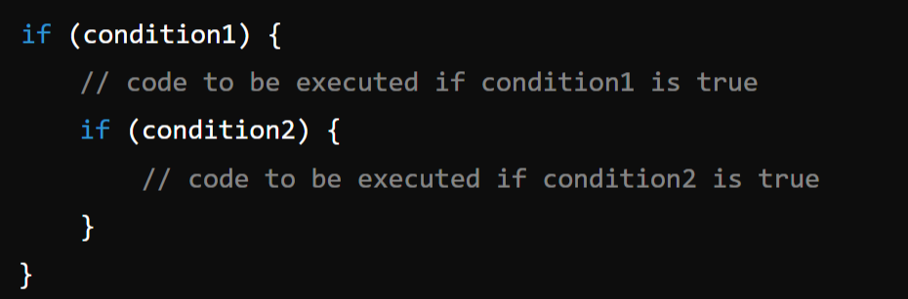
4. Nested if statement:
Nested if statements allow an if statement to be placed inside another if statement. This allows for more complex decision-making processes where multiple conditions must be true for a block of code to execute.
Syntax:

Slide 67
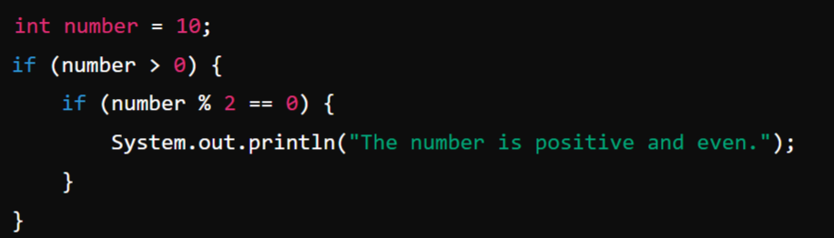
Example:

Slide 68
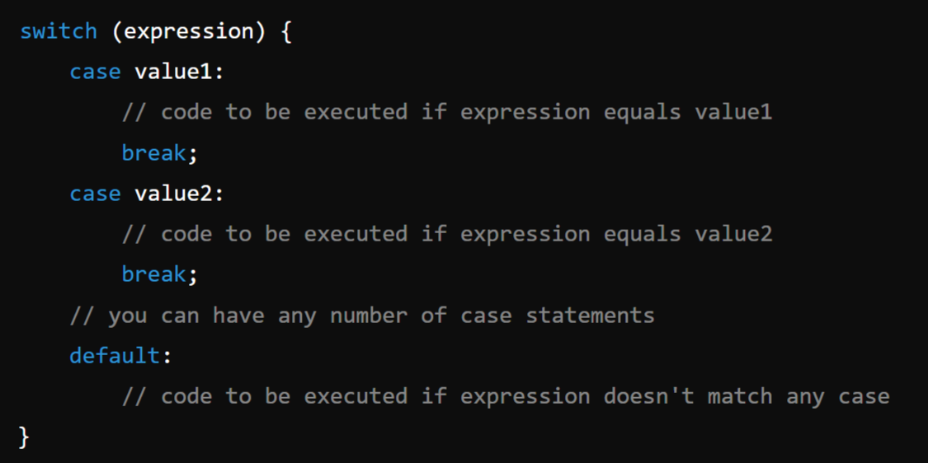
5. Switch statement:
The switch statement evaluates an expression and compares it to a list of case values. When a match is found, the corresponding block of code is executed. The break statement is used to exit the switch block after the matched case has been executed. If no match is found, the default block (if present) is executed. The switch statement is often used as an alternative to the if-else-if ladder for better readability and performance when dealing with multiple possible values of an expression.
Syntax:

Slide 69
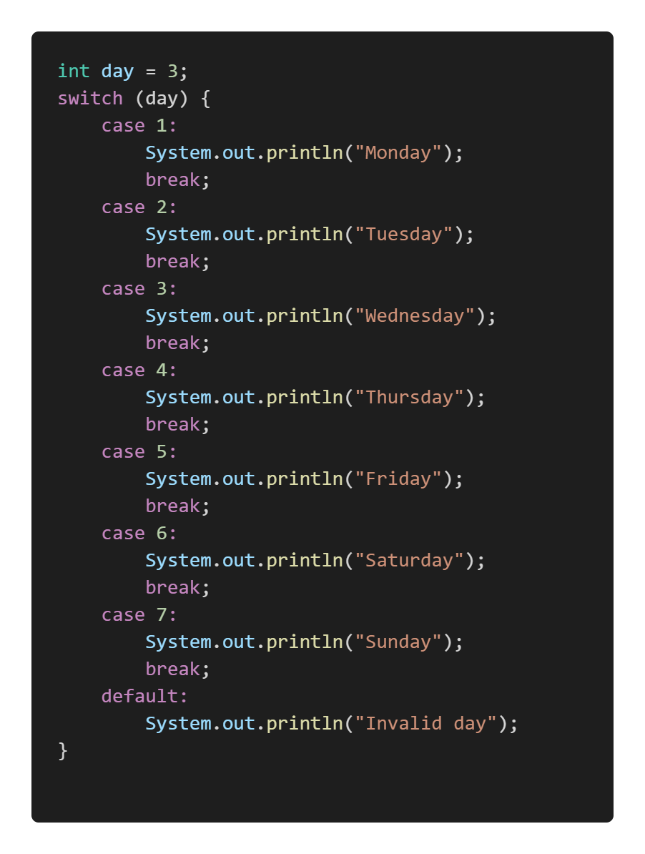
Example:

Slide 70
2. Loop Statements:
In Java, loop statements allow the execution of a block of code repeatedly based on a condition. They are essential for tasks that require iteration, such as processing elements in an array or repeatedly performing an operation until a certain condition is met.
Looping Statements are:
for loop
while loop (Entry Controlled Loop)
do-while loop (Exit Controlled Loop)
for-each loop (enhanced for loop)

Slide 71
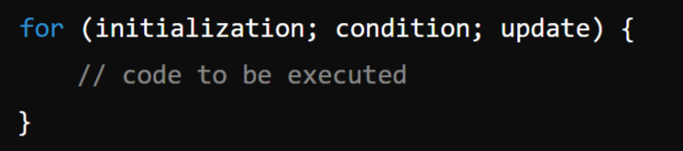
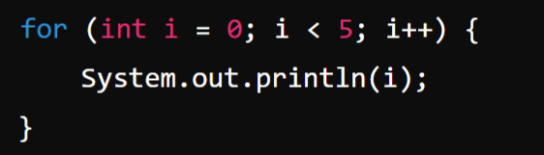
1. for loop:
The for loop provides a concise way of writing the loop structure. It is used when the number of iterations is known beforehand.
Syntax:
Example:

Slide 72
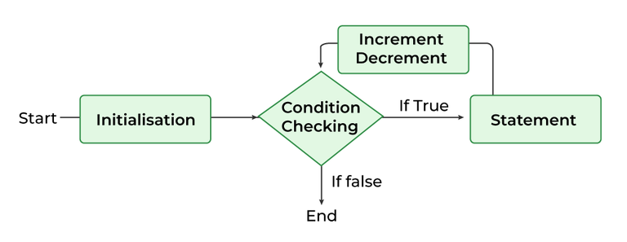
for Loop Flow Chart:

Slide 73
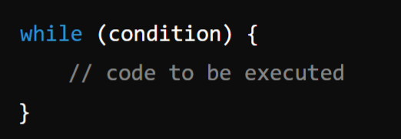
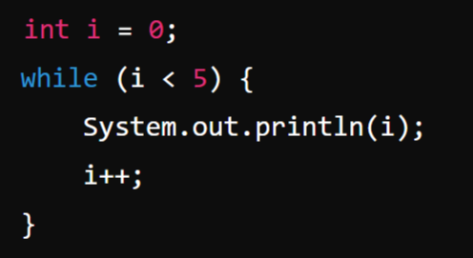
2. while loop:
The while loop continually executes a block of code as long as a specified condition is true. The condition is checked before the execution of the loop body, making it a pre-test loop.
Syntax & Example:

Slide 74
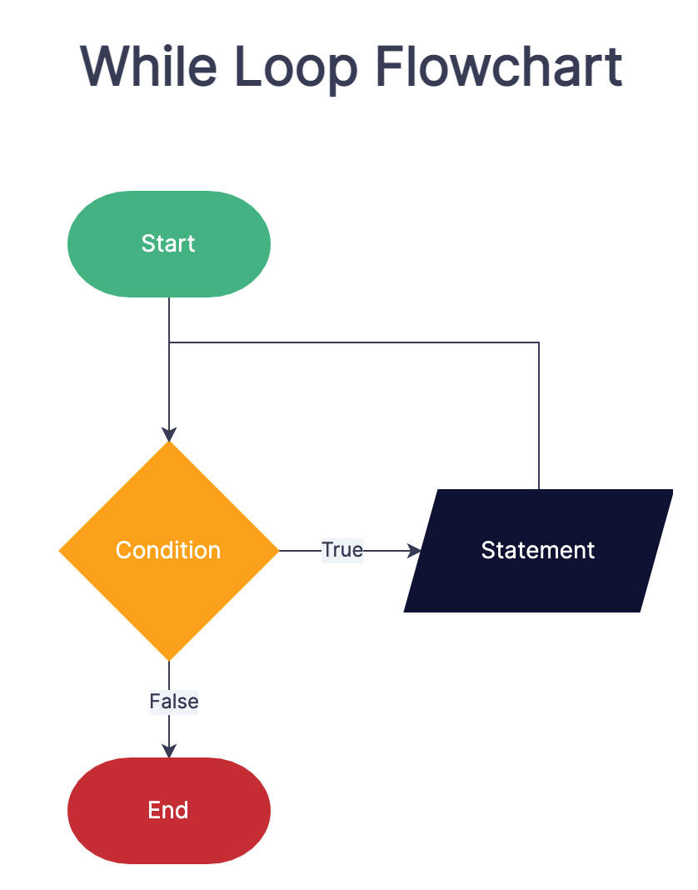

Slide 75
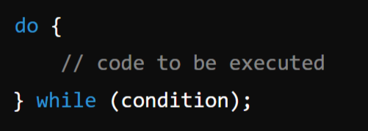
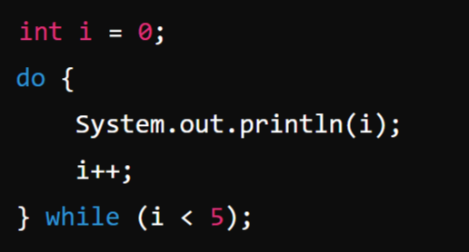
3. do-while loop:
The do-while loop is similar to the while loop, but it guarantees that the loop body will be executed at least once because the condition is checked after the execution of the loop body.
Syntax & Example:

Slide 76
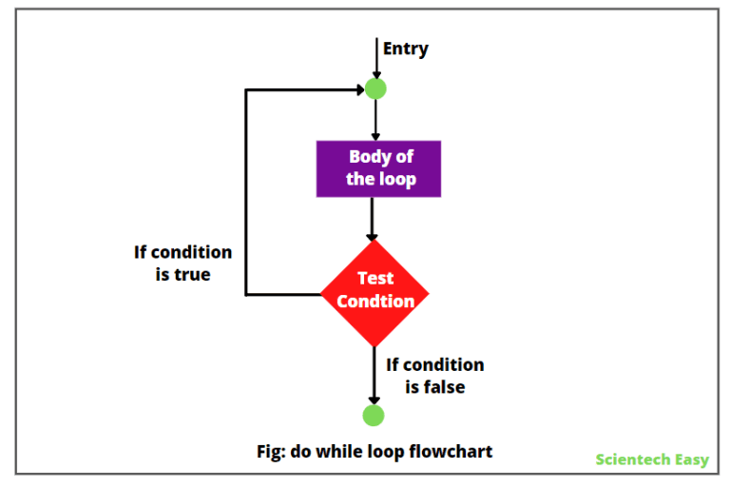
do-while Loop Flow Chart

Slide 77
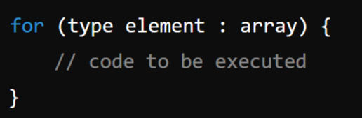
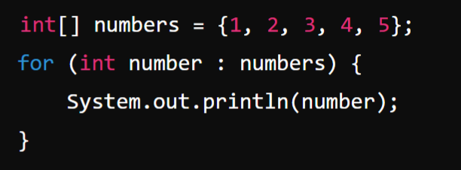
4. for-each loop (Enhanced for loop)
The for-each loop, introduced in Java 5, is used to iterate over elements in an array or a collection, making the code more readable and reducing the risk of errors.
Syntax:
Example:

Slide 78
3. Branching or Jump Statements:
In Java, branching statements are used to alter the flow of execution within a program based on certain conditions. They allow for more complex and dynamic behavior by enabling jumps to different parts of the code.
The main branching statements in Java are:
break
continue
return

Slide 79

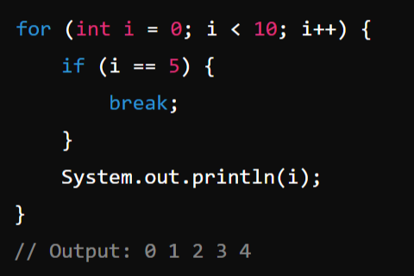
1. break statement:
The break statement is used to terminate the execution of a loop or switch statement prematurely. It can be used in for, while, and do-while loops, as well as in switch statements.
Syntax:
Example: When a break statement is encountered inside a loop or switch, control is transferred to the statement immediately following the loop or switch.

Slide 80


2. continue statement:
The continue statement is used to skip the current iteration of a loop and proceed to the next iteration. It can be used in for, while, and do-while loops.
Syntax:
Example: When a continue statement is encountered inside a loop, control is immediately transferred to the next iteration of the loop, bypassing the remaining code in the current iteration.

Slide 81


3. return statement
The return statement is used to exit from the current method and optionally return a value to the calling method. It can be used in any method to terminate its execution and, if needed, provide a value back to the caller.
Syntax:
Example-1: When a return statement is encountered, the method execution is terminated, and control is returned to the caller. If the method has a return type other than void, a value must be returned.

Slide 82

Example-2: Method that returns a value:

Slide 83

Constants:
In Java, a constant is a variable whose value cannot be changed once it is assigned. Constants are used when you want to define a value that should remain the same throughout the execution of a program. Constants provide several benefits, including making code more readable, reducing the likelihood of errors, and making it easier to modify values that are used in multiple places.
Example:

Slide 84
Scope and life time of variables
In Java, the scope and lifetime of variables are determined by where the variables are declared and how they are used.
1. Scope of Variables
The scope of a variable refers to the region of the program where the variable can be accessed.
2. Lifetime of Variables
The lifetime of a variable refers to the duration for which the variable exists in memory during the execution of a program.

Slide 85

Example:

Slide 86
Local Variables:
Scope:
Local variables are declared inside a method, constructor, or block of code (e.g., loops, conditional statements).
They are only accessible within the method, constructor, or block in which they are declared.
Lifetime:
The lifetime of a local variable begins when the method, constructor, or block in which it is defined is invoked, and ends when the method, constructor, or block is exited.

Slide 87


Example-1:
Example-2:

Slide 88
2. Instance Variables:
Scope: Defined inside a class but outside any method. They belong to an instance of the class.
Lifetime: The lifetime of an instance variable begins when an object is created using the new keyword and lasts until the object is eligible for garbage collection.
3. Static Variables:
Scope: Defined inside a class with the static keyword. They belong to the class itself rather than any instance.
Lifetime: The lifetime of a static variable begins when the class is loaded into memory and lasts until the class is unloaded. Static variables are shared among all instances of the class.

Slide 89

Example: static and instance variables:

Slide 90
Operators in Java:
In Java, an operator is a symbol that performs operations on one or more operands. Operands are the values on which the operator operates. Operators are used to manipulate data and variables.
Java supports various types of operators, including:
Unary Operators
Binary Operators
Arithmetic Operators
Relational Operators
Logical Operators
Assignment Operators
Bitwise Operators
Ternary Operator

Slide 91
Unary Operators: Which operates on only one Operand.
Operator | Description | Example
+ | Unary plus, indicates a positive value. | +a
- | Unary minus, negates the expression. | -a
++ | Increment operator, increases the value by 1. | a++, ++a
-- | Decrement operator, decreases the value by 1. | a--, --a
! | Logical NOT, inverts the value of a boolean. | !true

Slide 92
2. Binary Operators: Operate on two operands
1. Arithmetic Operators:
Operator | Description | Example
+ | Addition, adds two operands. | a + b
- | Subtraction, subtracts the second operand from the first. | a - b
* | Multiplication, multiplies two operands. | a * b
/ | Division, divides the numerator by the denominator. | a / b
% | Modulus, returns the remainder of the division. | a % b

Slide 93
2. Relational Operators:
Relational operators in Java are used to compare two values and return a boolean result (true or false). a=10, b=20
Operator | Description | Example
== | Equal to, checks if two operands are equal. | a == b
!= | Not equal to, checks if two operands are not equal. | a != b
> | Greater than, checks if the left operand is greater than the right. | a > b
< | Less than, checks if the left operand is less than the right. | a < b
>= | Greater than or equal to, checks if the left operand is greater than or equal to the right. | a >= b
<= | Less than or equal to, checks if the left operand is less than or equal to the right. | a <= b

Slide 94
3. Logical Operators:
Logical operators in Java are used to perform logical operations on boolean expressions. They are commonly used in conditional statements to combine multiple conditions.
Operator | Description | Example
&& | Logical AND, returns true if both operands are true. | a && b
|| | Logical OR, returns true if any one of the operand is true. | a || b
! | Logical NOT, inverts the value of a boolean operand. | !a

Slide 95
4. Assignment Operators:
Operator | Description | Example
= | Simple assignment, assigns the right operand to the left operand. | a = b
+= | Addition assignment, adds right operand to left operand and assigns the result to the left operand. | a += b
-= | Subtraction assignment, subtracts right operand from left operand and assigns the result to the left operand. | a -= b
*= | Multiplication assignment, multiplies right operand with left operand and assigns the result to the left operand. | a *= b
/= | Division assignment, divides left operand by right operand and assigns the result to the left operand. | a /= b
%= | Modulus assignment, calculates modulus using two operands and assigns the result to the left operand. | a %= b

Slide 96
5. Bitwise Operators:
Bitwise operators in Java perform bit-level operations on integer types (int, long, short, char, byte). These operators work directly on the binary representation of numbers.
Operator | Description | Example
& | Bitwise AND, performs a bitwise AND operation. | a & b
| | Bitwise OR, performs a bitwise OR operation. | a|b
^ | Bitwise XOR, performs a bitwise XOR operation. | a ^ b
~ | Bitwise NOT, inverts all the bits of the operand. | ~a
<< | Left shift, shifts the bits of the left operand left by the number of positions specified by the right operand. | a << b
>> | Right shift, shifts the bits of the left operand right by the number of positions specified by the right operand. | a >> b
>>> | Unsigned right shift, shifts zero into the leftmost bits. | a >>> b

Slide 97
Truth Table:
1. &:
2. | :
3. ~
4. ^
A | B | A & B
0 | 0 | 0
0 | 1 | 0
1 | 0 | 0
1 | 1 | 1
A | !A
0 | 1
1 | 0
A | B | A | B
0 | 0 | 0
0 | 1 | 1
1 | 0 | 1
1 | 1 | 1
A | B | A | B
0 | 0 | 1
0 | 1 | 0
1 | 0 | 0
1 | 1 | 1

Slide 98



Example:
&
|
~

Slide 99

3. Ternary Operator
The ternary operator in Java, also known as the conditional operator, is a shorthand for an if-else statement. It has three operands and is used to evaluate a condition and return one of two values, depending on whether the condition is true or false.
Syntax:
Where,
condition: This is a boolean expression that evaluates to either true or false.
expression1: This is the value returned if the condition is true.
expression2: This is the value returned if the condition is false.

Slide 100

Example:

Slide 101
Module-1: OOPS CONCEPTS AND JAVA PROGRAMMING:
OOP concepts: Classes and objects, data abstraction, encapsulation, inheritance, benefits of inheritance, polymorphism, procedural and object oriented programming paradigm.
Java programming: History of java, comments, data types, variables, constants, scope and life time of variables, operators, operator hierarchy, expressions, type conversion and casting, enumerated types, control flow statements, jump statements, simple java stand alone programs, arrays, console input and output, formatting output, constructors, methods, parameter passing, static fields and methods, access control, this reference, overloading methods and constructors, recursion, garbage collection, exploring string class.

